Slide 1
Australia’s
Aborigines
Origins & Culture

Slide 2
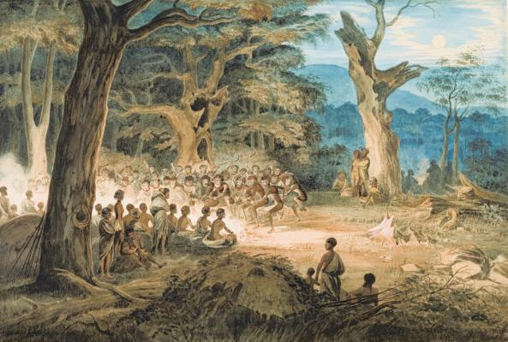
Aborigines
Aborigines are the indigenous people of Australia.
They have occupied Australia for at least 40,000 years!
They arrived from Southeast Asia.
The word aborigines means “people who were here from the beginning”.
This Photo by Unknown Author is licensed under CC BY-SA

Slide 3
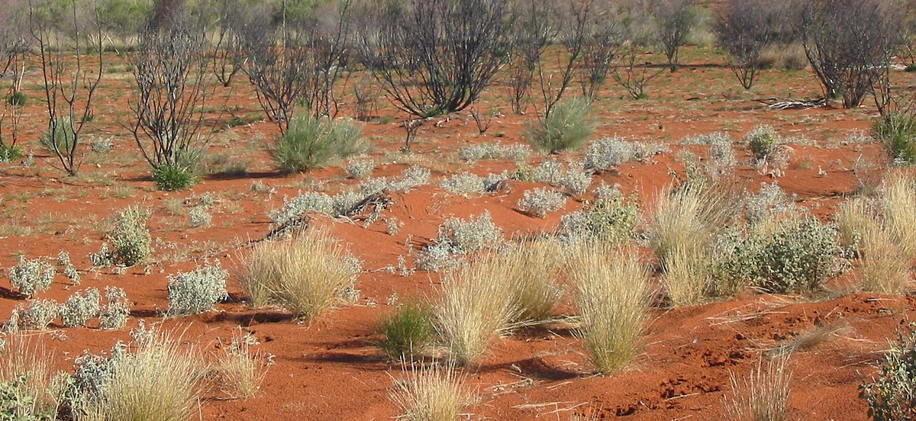
Early Life
They developed efficient ways to adapt to the harsh Australian climate and environment.
They built containers for storing water and built wells to collect water underground.
They were hunters and gatherers: ate animals, wild nuts, fruits, and berries.
They were nomadic--moved from place to place in search of food.
This Photo by Unknown Author is licensed under CC BY-SA

Slide 4
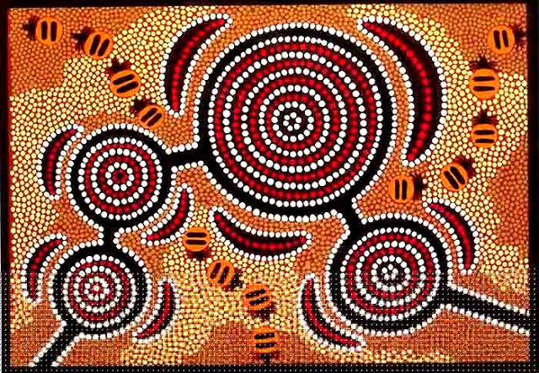
Early Life
Archaeologists have found several early Aboriginal inventions:
Rock art, boomerangs, ground axes, and grindstones
There is no written record of prehistoric Aborigines.
They kept their history by telling stories that were passed down from generation to generation.
This Photo by Unknown Author is licensed under CC BY-SA

Slide 5
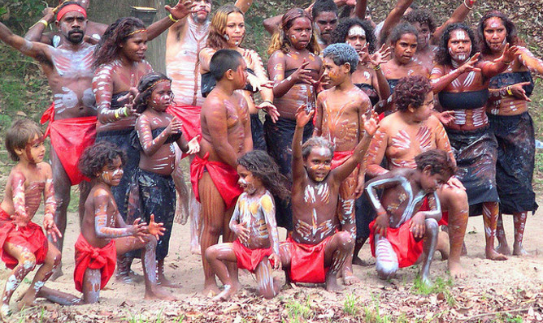
Social Structure
The Aboriginal social structure consisted of a tribe or “language group” of as many as 500 people.
A tribe included bands called “hordes” of 10 to 20 people.
Hordes joined for daily food gathering and hunting.
This Photo by Unknown Author is licensed under CC BY-ND

Slide 6
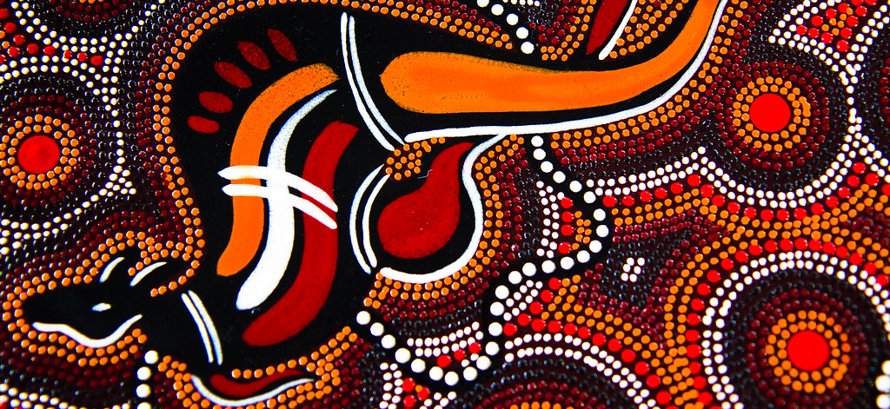
Where?
Aborigines originally settled in the same places as present-day Australians.
The climate was mild and water was available.
Before Europeans arrived in 1788, around 500,000 Aborigines lived in Australia.
This Photo by Unknown Author is licensed under CC BY-NC-ND

Slide 7
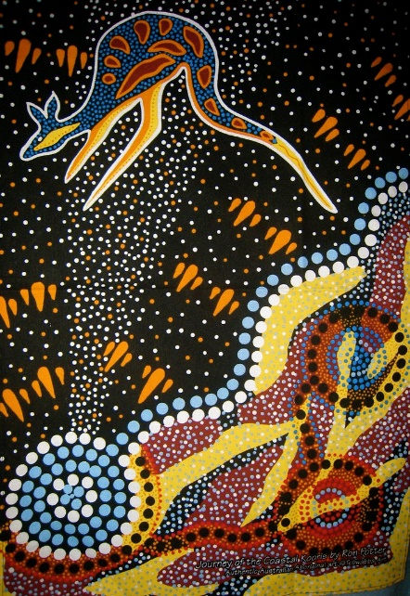
Religion
Aboriginal religion is called “Dreamtime”.
“The Dreaming” is what Aborigines call the beginning of life on Earth.
During the Dreaming, spirits created the land, people, and animals.
Most of the spirits disappeared, but some live on in objects.

Slide 8
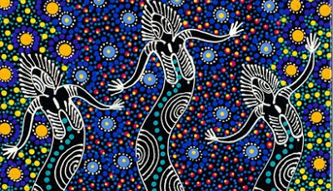
Dreamtime
Aborigines believe the earth is a link to the spiritual world.
The land itself is sacred to Aborigines
For example, Ayers Rock, known as Uluru to the Aborigines, is a very sacred part of their religion.
Aborigines have many Dreamtime legends that describe how the earth was created.
This Photo by Unknown Author is licensed under CC BY-SA-NC

Slide 9
Aboriginal Art
Aboriginal art is a tradition thousands of years old!
The artwork most often depicts Dreamtime stories.
The best known forms of Aboriginal art are rock and bark paintings.
A more modern tradition is called, Papunya Tula, the “Dot Art” movement.
This Photo by Unknown Author is licensed under CC BY-SA

Slide 10
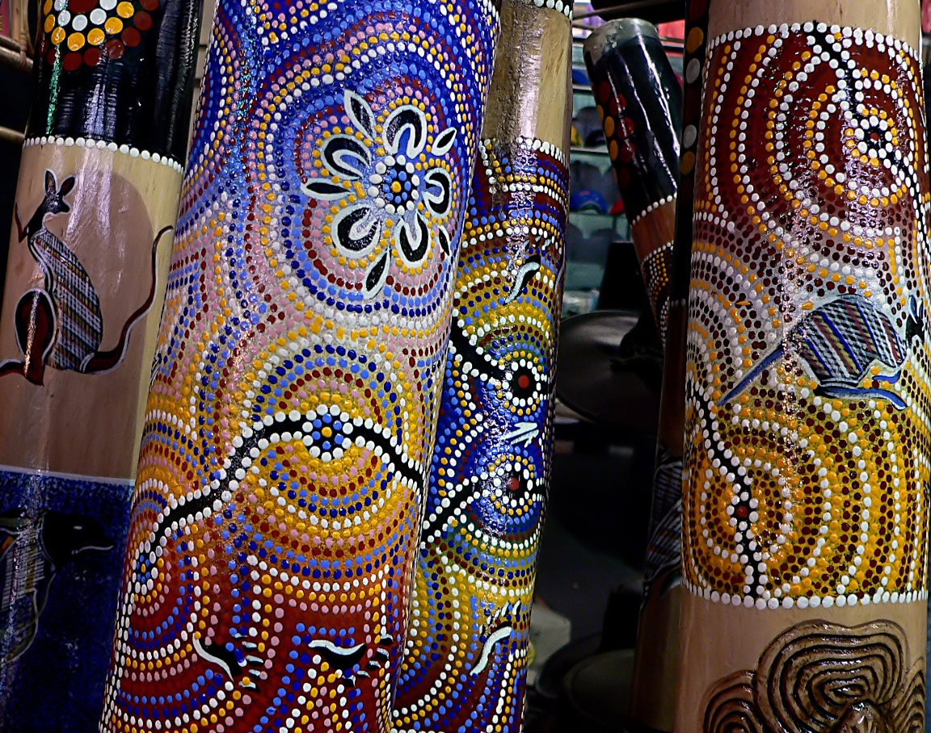
Music
The didgeridoo is the most famous Aboriginal musical instrument.
It is also know as a yirdaki.
Clapsticks, accompanying the didgeridoo, are used to keep a song’s rhythm.
Men played the didgeridoo, while women played the clapsticks.
https://app.discoveryeducation.com/learn/videos/BADFA6D5-256A-435D-86EC-E1B76E87ECED?hasLocalHost=false

Slide 11
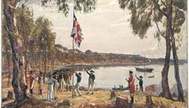
Arrival of Europeans
Aborigines lived on Australia’s coast, which is where the Europeans wanted to settle.
Europeans waged war against the Aborigines in order to take their land.
This Photo by Unknown Author is licensed under CC BY-SA

Slide 12
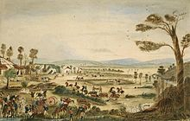
European Advantage
The Europeans had guns and soldiers.
They also spread diseases…
More than half of the Aborigines in Australia died.
The entire Aboriginal population died in Tasmania.
This Photo by Unknown Author is licensed under CC BY-SA

Slide 13
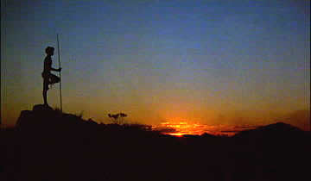
What Happened Next?
The Aborigines were forced to live on reservations in the Outback.
They were forced to work for Europeans on sheep and cattle ranches.
Laws were made to limit where Aborigines could live and work.
Children were even taken away from their parents and sent to European schools.
The British hoped to end all Aboriginal culture with their policies.
This Photo by Unknown Author is licensed under CC BY-NC-ND

Slide 14
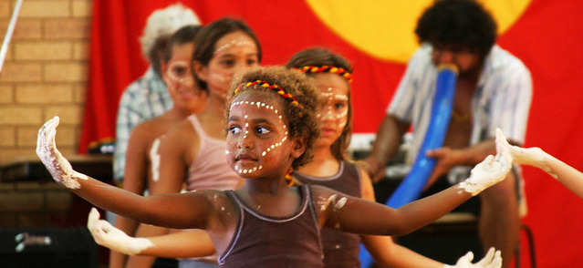
Aborigines Today
Only 300,000 Aborigines live in Australia today.
In the 1960s, policies were changed to be more in favor of Aborigines:
They can hold a seat in Parliament.
They can have their own schools which teach their culture, language, and art.
Today, they live modern lives, some are teachers, lawyers, mechanics, nurses, politicians, etc.
This Photo by Unknown Author is licensed under CC BY

